Slide 1


STAT 387 Introduction to Statistical Learning Winter 2022 German Credit
Keaton Spiller

Slide 2
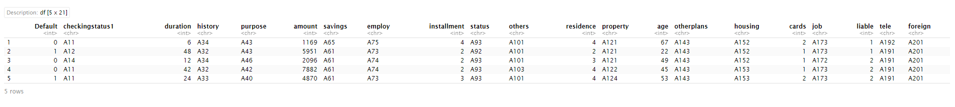
Exploratory Analysis
Are there any interesting patterns in the data?
Goal is Logistic prediction on Default {0,1}
Default = Y

Slide 3
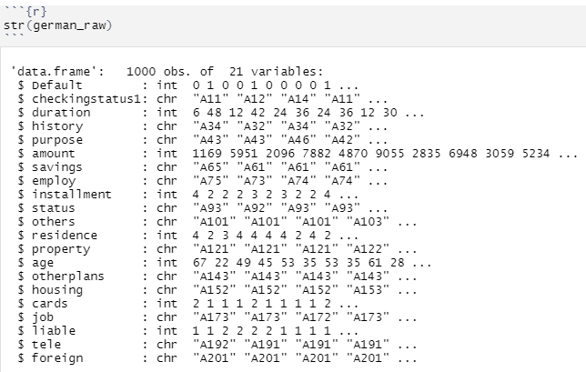
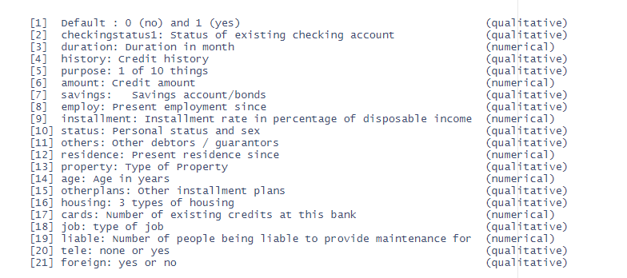
14 Categoric & 7 Numeric Variables
Dealing with Categorical Variables

Slide 4
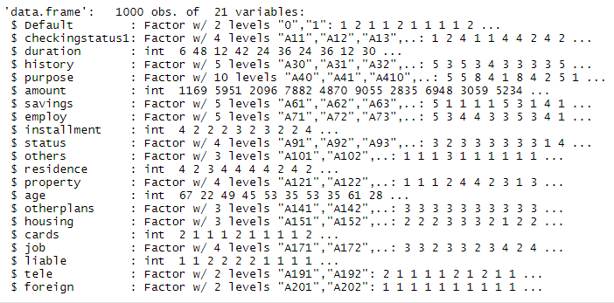
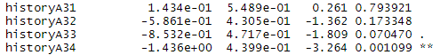
Now the variables are in Factor form and our model can use dummy variables n-1 classes
History has 5 classes A30-A34
History A30 is reference & will not show up in the model summary

Slide 5
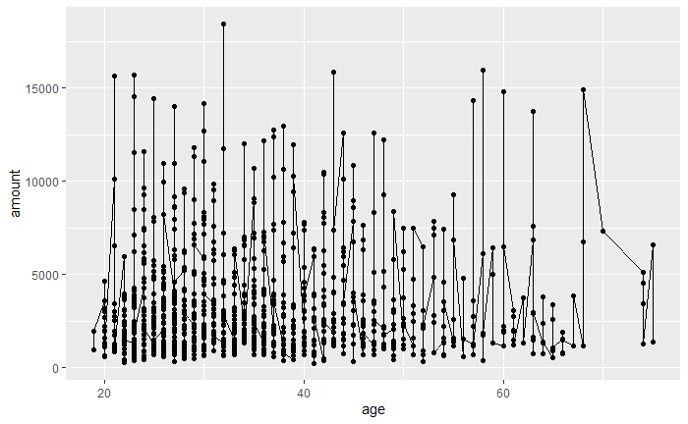
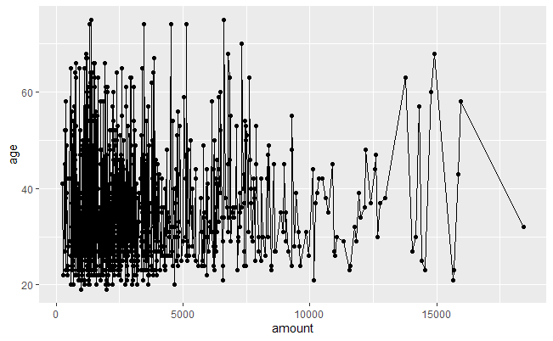
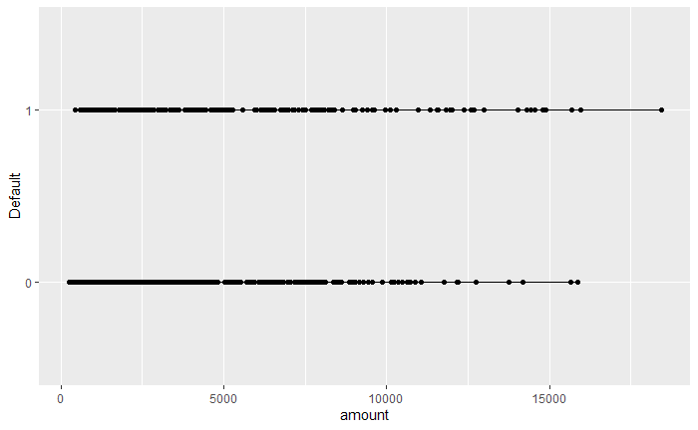
Plotting variables against each other
credit amount and age looked very interesting

Slide 6
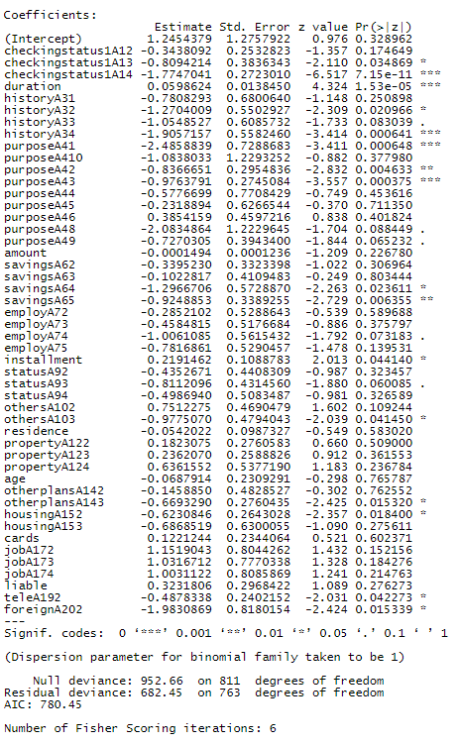
Let us Train and Test based on Amount
train =
amount < 5000
Test =
amount >= 5000
Building A Logistic Model
w/
Every variable
( Train = 812 rows 20 variables
Test = 188 rows 20 variables )
The logistic Model with every variable has an
AIC = 780.45

Slide 7
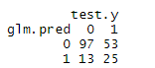
The confusion matrix of the logistic model predicted on test data without variable reduction
Accuracy:
TP+TN/(TP+TN+FP+FN)= 0.6489362
Error:
1- (TP+TN/(TP+TN+FP+FN))= 0.3510638
Sensitivity:
TN/TN+FP = 0.8818182
Specificity:
TP/FN+TP = 0.3205128
It is interesting the accuracy is ~65%, I was hoping for ~70%
AUC = 0.6978

Slide 8
Variable Reduction
Since Ridge, Lasso and anova with chi squared test weren’t apart of this class
Lets use StepAIC/BIC
I chose to use Forward and Backwards Step
AIC and BIC methods in my case gave the same variables and AIC values
We want smaller AIC values

Slide 9
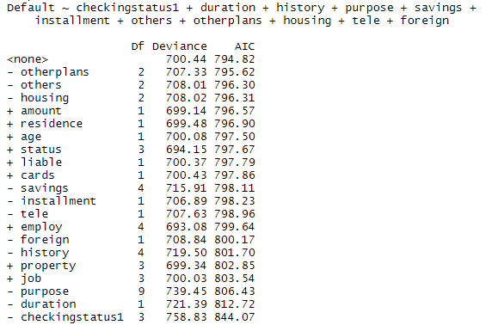
Variable Reduction
Stepping forwards adding variables and backwards removing variables based on lower AIC values
Stepping forwards adding variables and backwards removing variables based on lower AIC values
Variables Selected
checkingstatus1 + duration + history + purpose + savings + installment + others + age + otherplans + housing + tele + foreign
20 variables to 12
Counterintuitive (-) shows variables added to model

Slide 10
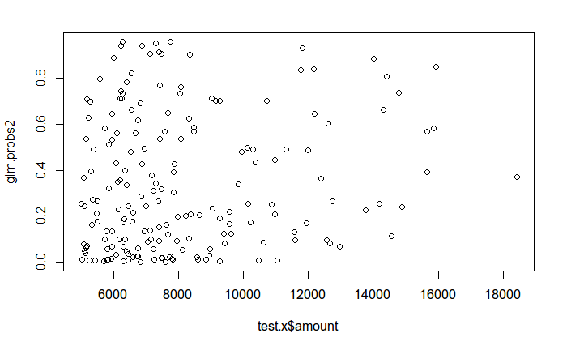
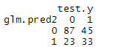
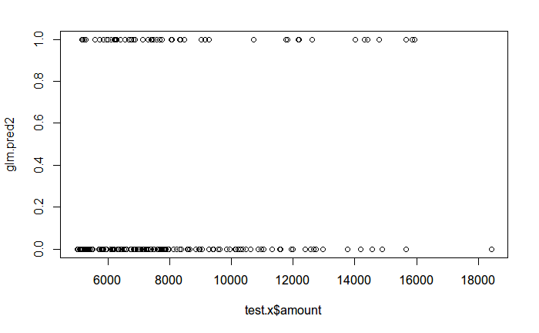
Variable reduced logistic model predicted on test data
Accuracy = 0.6382979
Error = 0.3617021
Sensitivity = 0.7909091
Specificity = 0.4230769
AUC = 0.7057 ( Higher AUC )

Slide 11
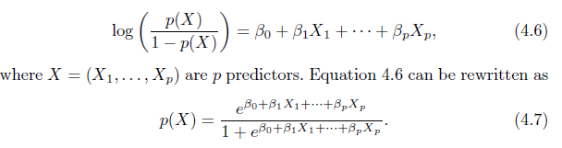
What is the Equation of the Logistic model?
Accuracy Difference
0.6382979 vs 0.6489362
10 fewer variables
AUC went from 0.6978 to 0.7057
In our case the X is a matrix with 12 variables
checkingstatus1 + duration + history + purpose + savings + installment + others + age + otherplans + housing + tele + foreign

Slide 12
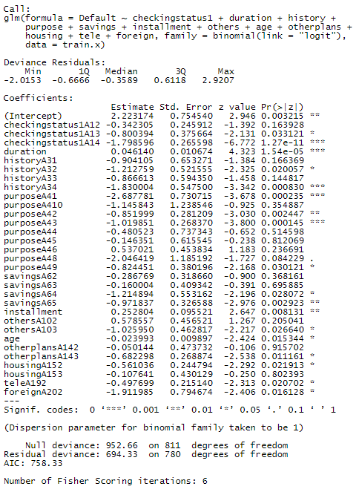
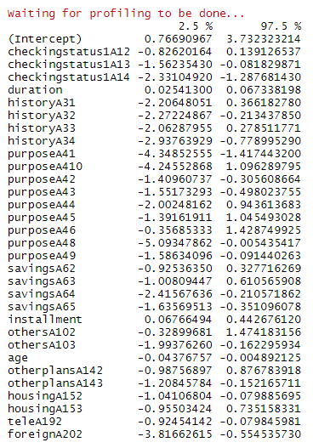
What is the Equation of the Logistic model?
Analyzing the coefficients and the 95% confidence interval
Summary of the
Variable Reduced logistic model

Slide 13
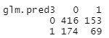
Logistic Model Train vs Test Error Rate?
Training error rate vs test error rate
training error Rate for the variable reduced Logistic model = 0.4027094
test error rate for the variable reduced logistic model = 0.3617021

Slide 14
Therefore
Based on train
Accuracy and Error
KNN is the best model
QDA has highest AUC
Multiple models trained and predicted on train data
Logistic, KNN, LDA,OR QDA?
Models | Accuracy | Error | Sensitivity | Specificity | AUC
Logistic full | 0.62 | 0.38 | 0.7985714 | 0.2033333 | 0.501
Logistic Reduced | 0.5972906 | 0.4027094 | 0.7050847 | 0.3108108 | 0.5079
KNN | 0.7549261 | 0.2450739 | 0.9491525 | 0.2387387 | 0.7828
LDA | 0.5751232 | 0.4248768 | 0.9135593 | 0.5135135 | 0.8352497
QDA | 0.5110837 | 0.4889163 | 0.7661017 | 0.8063063 | 0.8477248

Slide 15
Therefore
Based on test
Accuracy, Error, and AUC
LDA is the best
Multiple models trained on train data and predicted on test data
Logistic, KNN, LDA,OR QDA?
Models | Accuracy | Error | Sensitivity | Specificity | AUC
Logistic full | 0.6489362 | 0.3510638 | 0.8818182 | 0.3205128 | 0.6978
Logistic Reduced | 0.6382979 | 0.3617021 | 0.7909091 | 0.4230769 | 0.7057
KNN | 0.6170213 | 0.3829787 | 0.7909091 | 0.3717949 | 0.405
LDA | 0.6755319 | 0.3244681 | 0.8 | 0.5 | 0.7168998
QDA | 0.606383 | 0.393617 | 0.6181818 | 0.5897436 | 0.6618881

Slide 16
Bonus Slides
Cross Validation?
If we used LOOCV, K-fold what would it tell us in terms of model selection?
Therefore
Benefits to CV Methods?
LOOCV:
more Bias,less Variance
K-Fold:
less Bias, > Variance

Slide 17
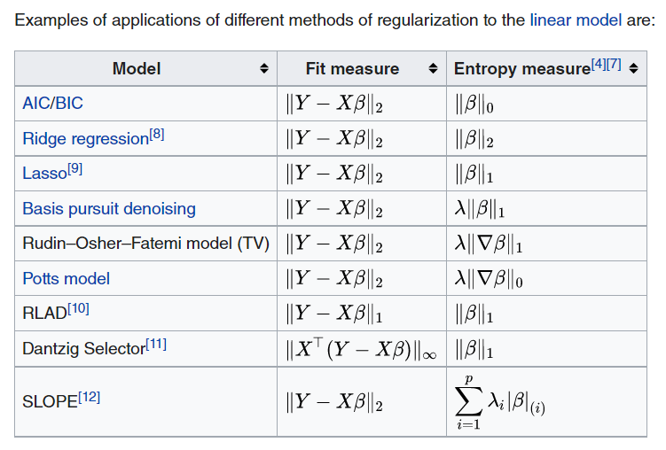
Bonus Slides
Ridge or Lasso For model selection (regularization)
Ridge:
L2 Selection
Small coefficients
Lasso:
L1 Selection
Large coefficients (Sparcity)

Slide 18
Bonus Slides
Chi square test for model selection
chisq.test() used for two categorical variables My data has multiple qualitative and quantitative variables
anova(model1,model2, test="Chisq")

Slide 19
Thank you For you time
Keaton Spiller

